Slide 1
Static analysis and verification for working programmers
Francesco Logozzo, Microsoft Research
M. Fahndrich, M. Barnett, H. Venter, T. Ball, S. Lahiri
P. & R. Cousot, M. Bouaziz, J.-H. Jourdan, V. Laviron, S. Blackshear , S. Carr

Slide 2
Let’s start with a demo!
Who can still make Binary search wrong?

Slide 3
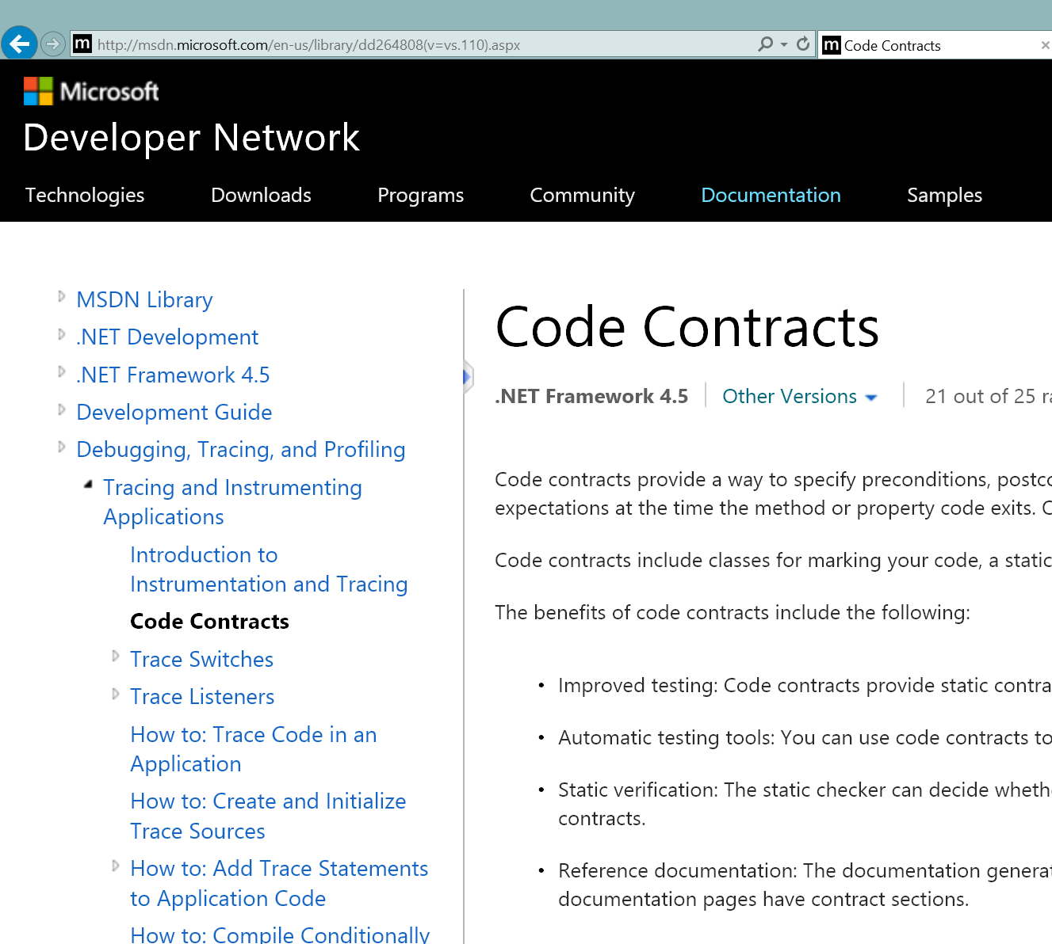
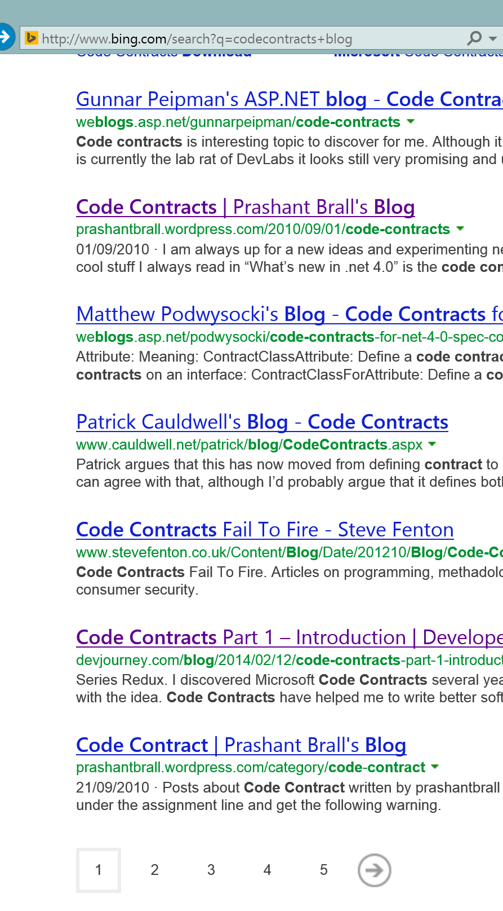
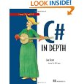

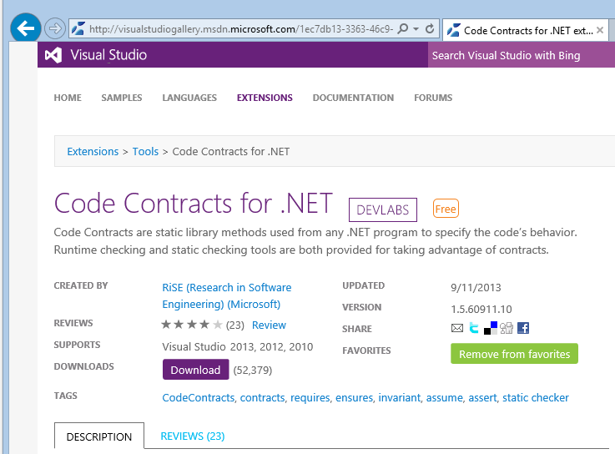
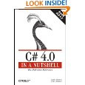
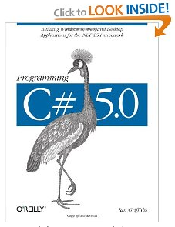
Is it real?
Popular, >160K downloads (VSGallery, Devlabs)
Many blogs, book chapters, articles …
Thousands of posts in MSDN forum, StackOverflow …
Talks @BUILD, DevScovery …
State of the art research
POPL, PLDI, OOPSLA, ECOOP, VMCAI, SAS …
Internal & external adoption
Specification API standard in .NET, 4.0+
Core MSFT software written with CC
Scales up to >80+ Mbytes assemblies!

Slide 4
What is static analysis for?
Falsification: Find bugs
If it reports an alarm ⟹ It is a bug
If silent ⟹ We do not know if there is some bug
Example: Coverity & Heartbleed bug
Verification: Prove there is no bug, for all inputs/execution paths
If it reports an alarm ⟹ We do not know if it is a bug
If silent ⟹ The code has no bug
Example: ASTREE & A3x0 code

Slide 5

CodeContracts static checker
Verification
Verification
Falsification
Verification
Falsification
Falsification
Continuum from falsification to verification
Set from IDE, but also programmatically, e.g., to focus on core components
Do not need annotations to use the tool, but
Need specifications to achieve verification
The static checker aggressively infers contracts to reduce the annotation burden
The more the annotations, the more code is verified, what left are bugs

Slide 6
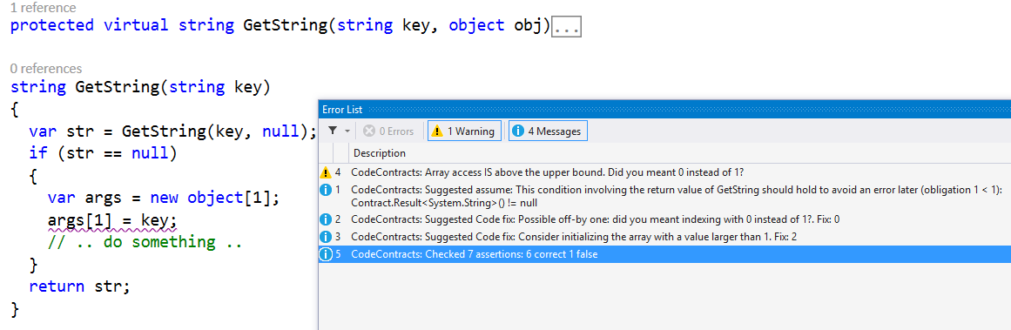
Falsification
Simplified example
from shipped code.
Bug has been fixed
Find bugs in your program
Propose bug fixes
Found a bug!

Slide 7
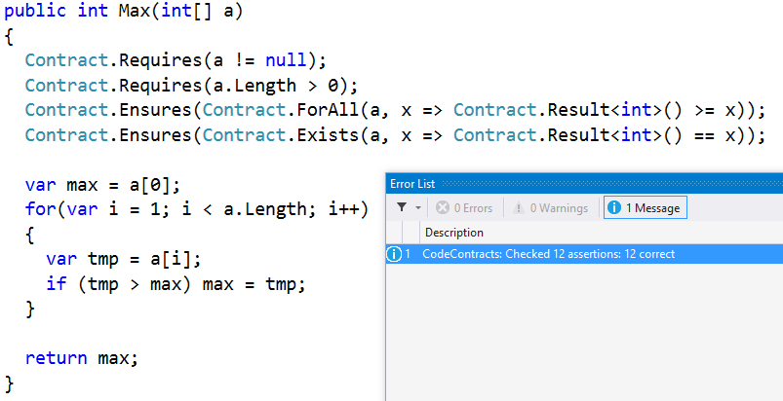
Verification
Prove there is no bug in your program, for all possible executions!
Need some spec
Spoiler alert:
This spec can also be inferred
Code is correct!

Slide 8
How it works?
No magic, just abstract interpretation

Slide 9
Inter-procedural analysis
compile
Assembly
analyze
MyProgram
C#, VB …
compile
Reference
Assemblies
My libraries
read
contracts
.NET core libraries
compile
Use contracts
for external libs
Bottom-up fix-point computation
Inference of pre-, post-, object invariants
What if libs do not have contracts?
Wait the end… ;-)

Slide 10

Intra-procedural analysis
Assertion violations
add
contracts
infer
invariants
check
⇒
generate
report
Dead Code
Code repairs
Alarm triage
use more refined
abstract domain
Contract inference
100% Abstract interpretation
semantic
hash
save
into cache
M. Fahndrich, F. Logozzo, Static contract checking with Abstract Interpretation, FoVeOOS 2010

Slide 11
Abstract domains in Clousot/cccheck
Needed for inference of (loop) invariants
Basic domains
IL decompilation, Expression recovery, Optimistic heap analysis, Nullness
Advanced domains
Numerical: Dis-Intervals, Pentagons, Subpolyhedra, (simple) Floating points …
Collections: Functor for arrays, ∀/∃-Quantifiers, array modifications …
Others: “lazy” trace partitioning, un-interpreted functions, Enums, strings …
P. Cousot, R. Cousot, F. Logozzo, A Parametric Segmentation Functor for Fully Automatic and Scalable Array Content Analysis, POPL’11
V. Laviron, F. Logozzo, SubPolyhedra: A (more) scalable approach to infer linear inequalities, VMCAI’11
P. Ferrara, F. Logozzo, M. Fähndrich, Safer unsafe code for .NET, OOPSLA’08
….

Slide 12
Inter-procedural Inference
The tool should help the programmer, not the other way around

Slide 13
Inference of contracts
Ideally the software engineer provides all the boundary contracts
As she does with types today
In practice she only provides “few”, the one she thinks are interesting
If the tool cannot infer “evident” contracts then it is labeled as “dumb”
E.g. return new A()
Vision: The tool should help the programmer not the other way around

Slide 14
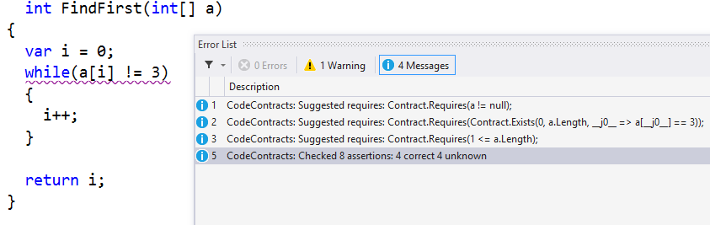
Preconditions
Infer necessary preconditions: If violated, the program will go wrong
No false alarm on precondition violation!
Inferred preconditions
P. Cousot, R. Cousot, F. Logozzo: Precondition Inference from Intermittent Assertions and Application to Contracts on Collections. VMCAI’11
P. Cousot, R. Cousot, M. Fahndrich, F. Logozzo, Automatic Inference of Necessary Preconditions, VMCAI’13

Slide 15
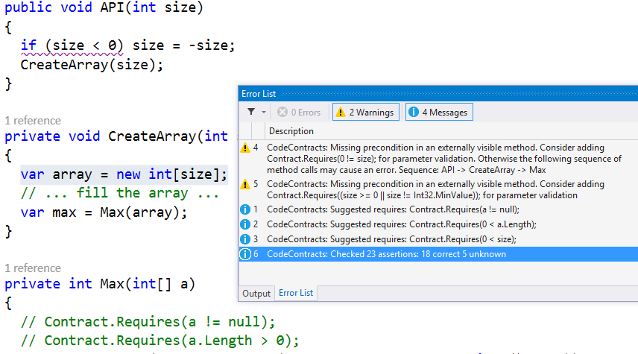
Inter-procedural propagation
Trace
to the error
Inferred preconditions

Slide 16
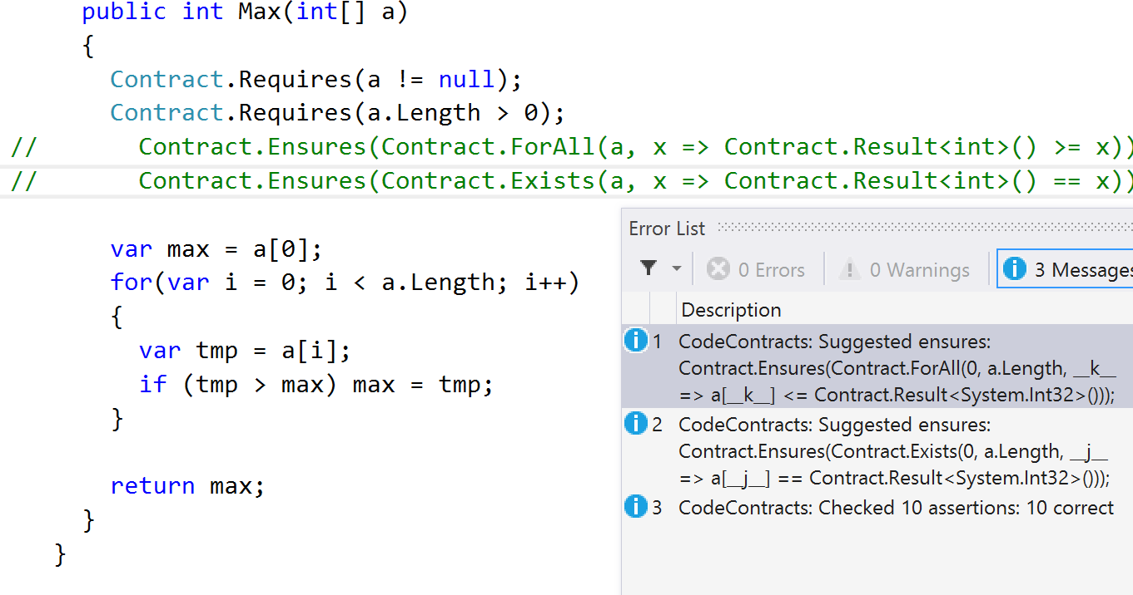
Postconditions
Infer postcondition

Slide 17
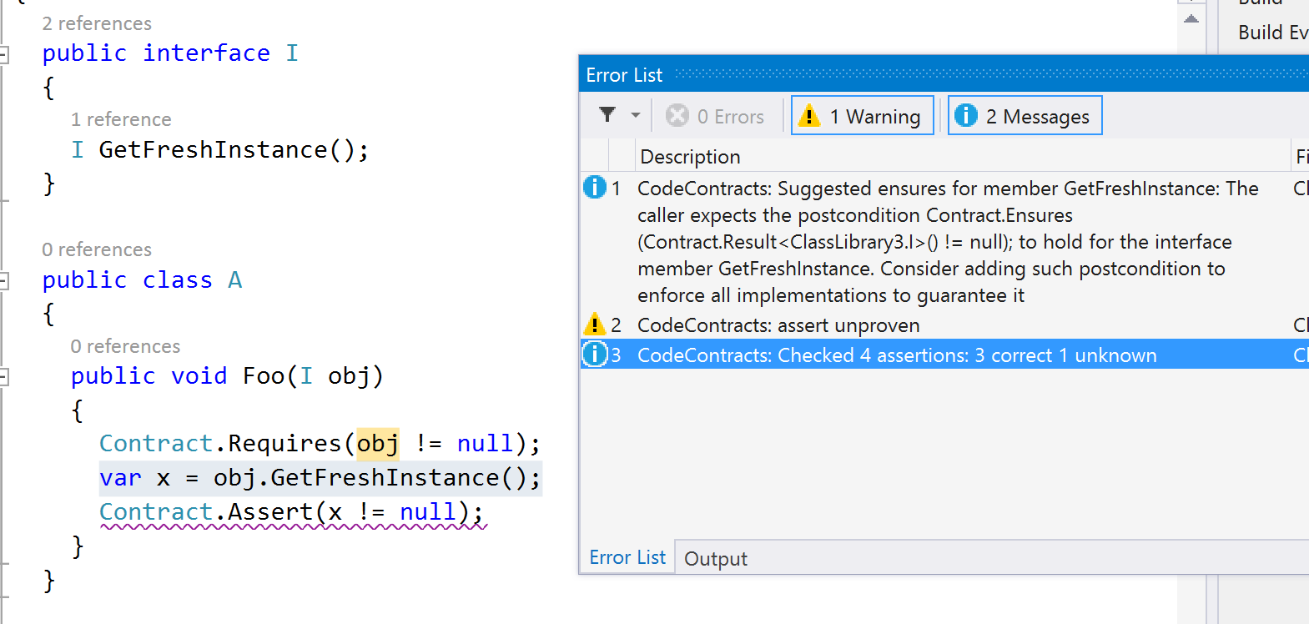
Can we infer everything?
Infer necessary post

Slide 18
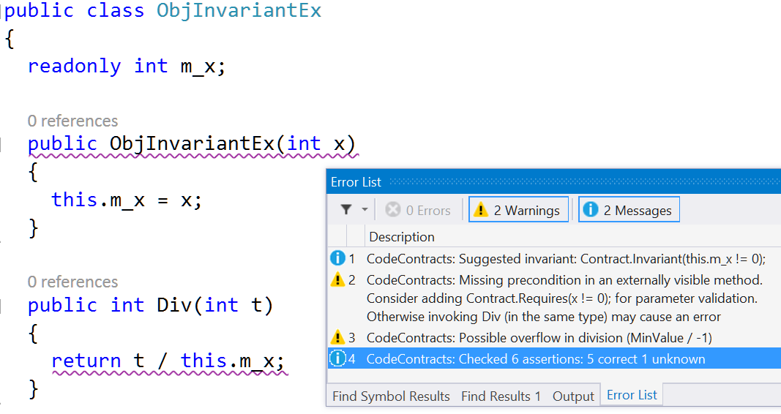
Object invariants inference
Infer
object invariant
Infer wrong usage
M. Bouaziz, F. Logozzo, M. Fahndrich, Inference of Necessary Field Conditions with Abstract Interpretation, APLAS’12

Slide 19
Dealing with warnings
The static analysis pain point

Slide 20
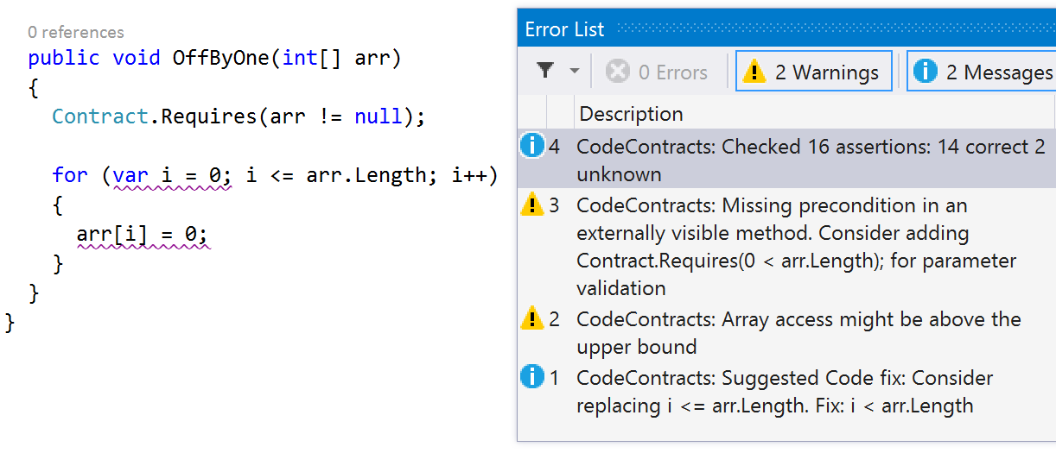
Code Repairs
Alarm
Suggest fix
F. Logozzo, T. Ball, Modular and Verified Automatic Program Repair, OOPSLA'12
F. Logozzo, M. Martel, Automatic Repair of Overflowing Expressions with Abstract Interpretation, in Festschrift for Dave Schmidt, 2013

Slide 21
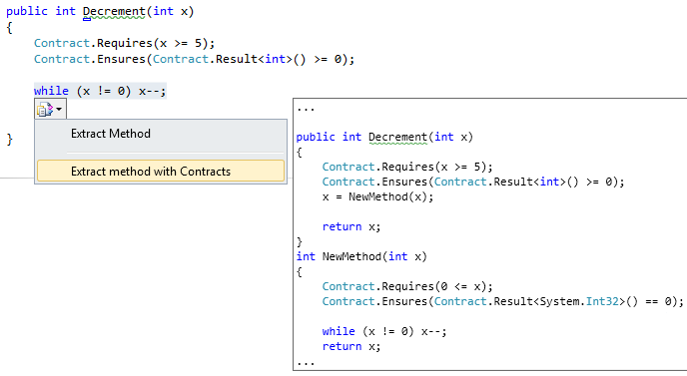
Proof-preserving Refactoring
P. Cousot, R. Cousot, F. Logozzo, M. Barnett,
An Abstract Interpretation Framework for Refactoring with Application to Extract Methods with Contracts, OOPSLA’12

Slide 22
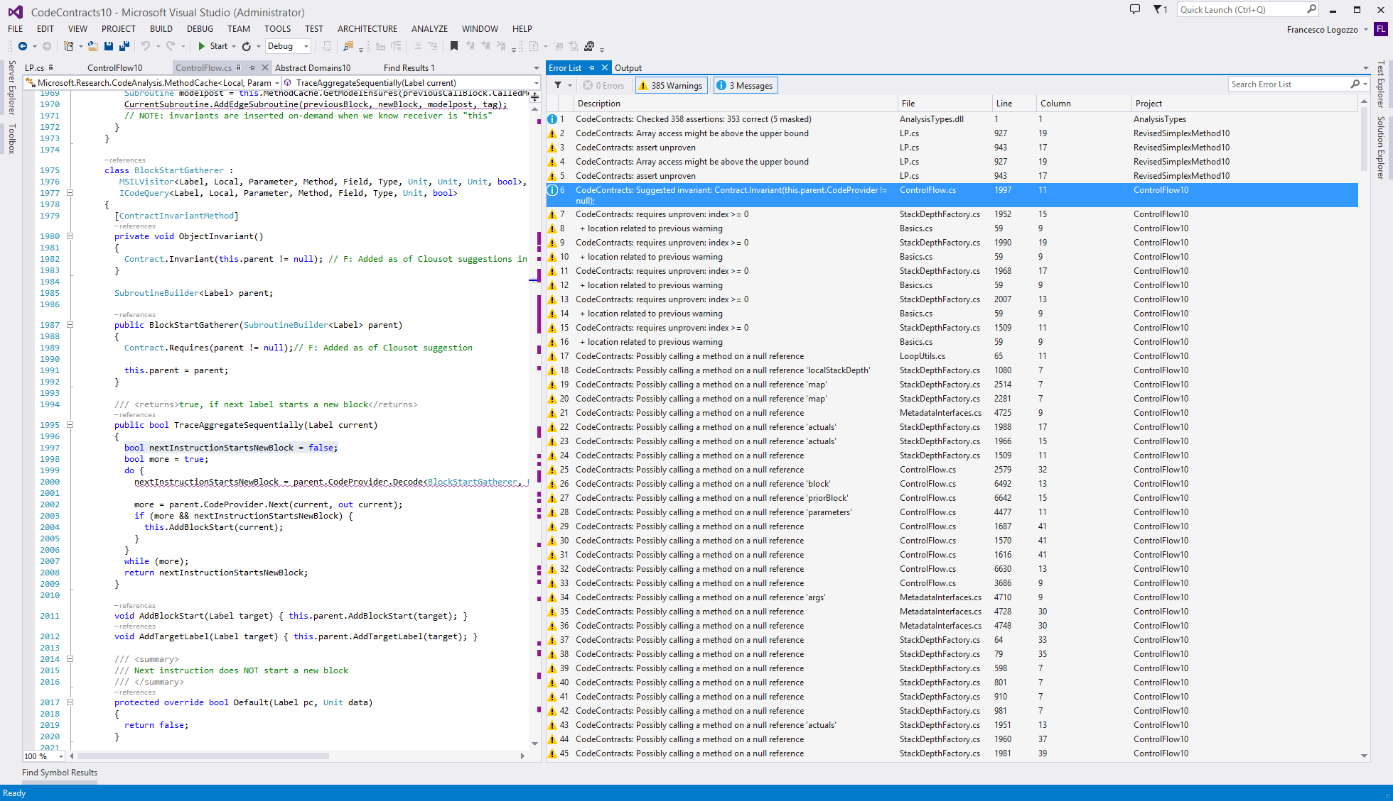
Too many warnings
Because of missing contracts on
external libs
Notes:
Now, what is the problem? Take your program or library, run cccheck and you get many, many warnings!

Slide 23


VMV: Verification modulo versions
P
Base version
P’
New version
Instrument
P’+C
Instrumented
Analyze
Analyzer is a black box
Reduce alarms up to 70%
With semantic guarantees!!!
Analyze
Extract semantic conditions C
F. Logozzo, S. Lahiri, M. Fahndrich, S. Blackshear, Verification Modulo Versions: Towards Usable Verification, PLDI’14

Slide 24
VMV(S): Finding regressions
Base version
Instrumented
new version
/// Get temperature in Kelvin
double GetCurrTemperature()
{
// In Celsius
1: var c = ReadTemperature();
2: var k = c + 273.15;
3: Contract.Assert(k >= 0);
4: return k;
}
/// Get temperature in Kelvin
double GetCurrTemperature()
{
// In Celsius
1: var c = ReadTemperature();
Contract.Assume(c >= -273.15);
2: var k = c + 273.0;
3: Contract.Assert(k >= 0);
4: return k;
}
Result(ReadTemperature) ≥ -273.15
Correct
⇔
c ≥ -273.15
Report regression!

Slide 25
VMV(N): Relative proofs
Base version
Instrumented
new version
/// Get temperature in Kelvin
double GetCurrTemperature()
{
// In Celsius
1: var c = ReadTemperature();
2: var k = c + 273.15;
3: Contract.Assert(k >= 0);
4: return k;
}
/// Get temperature in Kelvin
double GetCurrTemperature()
{
// In Celsius
1: var c = ReadTemperature();
Contract.Assume(c >= -273.15);
2: var k = c + 273.15;
3: var round = Math.Round(k, 2);
4: Contract.Assert(round >= 0);
5: return round;
}
Result(ReadTemperature) ≥ -273.15
Correct
⇔
c ≥ -273.15
Relative correctness

Slide 26
Time is over…
I am Italian, I speak too much

Slide 27
Conclusions
cccheck is arguably the most used static analyzer of its class
Based on abstract interpretation, modular, scalable …
Used on daily basis in production environments, in & out Microsoft
Most extreme: Fail build on cccheck alarm
Report alarms, conditions to errors, semantic code fixes, refactoring, VMV …
Continuum from falsification to verification
The more the contracts, the more the guarantees on the code
State of the art inter-procedural and intra-procedural inference

Slide 28
Backup slides
Just in case…

Slide 29
FAQ: Do you use an SMT solver?
NO. We are 100% Abstract interpretation based. Why?
Performance: conversion from abstract domains to SMT format, inter-proc calls …
Non-determinism: randomization, time-outs
Predictability: Small program changes should not change output
Semantics: Different tools make different assumptions (e.g., on Int32, Floats …)
Modelling: How to effectively model all .NET metadata?
Overdoing: Do not have assertions like ∀y. ∃x. ∀y. …
….

